Slide 1


Azure Boards
This document is confidential and contains proprietary information, including trade secrets of CitiusTech. Neither the document nor any of the information contained in it may be reproduced or disclosed to any unauthorized person under any circumstances without the express written permission of CitiusTech.

Slide 2
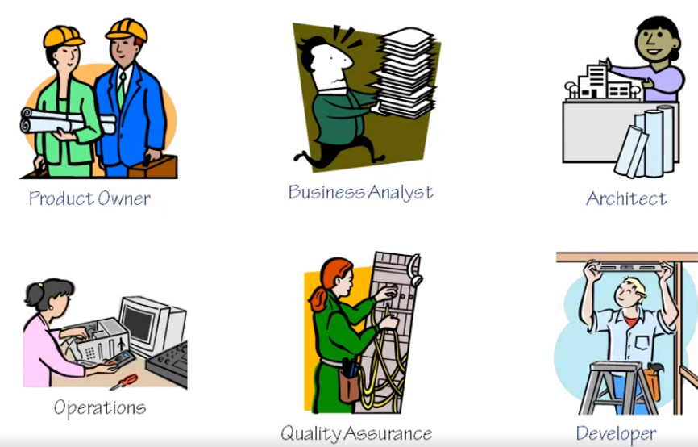
Roles in Software Development

Slide 3
Software Development Models
They show the ways to navigate through the complex and demanding process of software building
A project’s quality, timeframe, budget, and ability to meet the stakeholders’ expectations largely depend on the chosen model
They are a series of phases
They can be thought of as tools which can be used to better deliver a software
Types of Models:
Waterfall Model
V-Shaped Model
Evolutionary Prototyping Model
Spiral Model
Rational Unified Process
Iterative & Incremental Model
Agile/Scrum Model

Slide 4
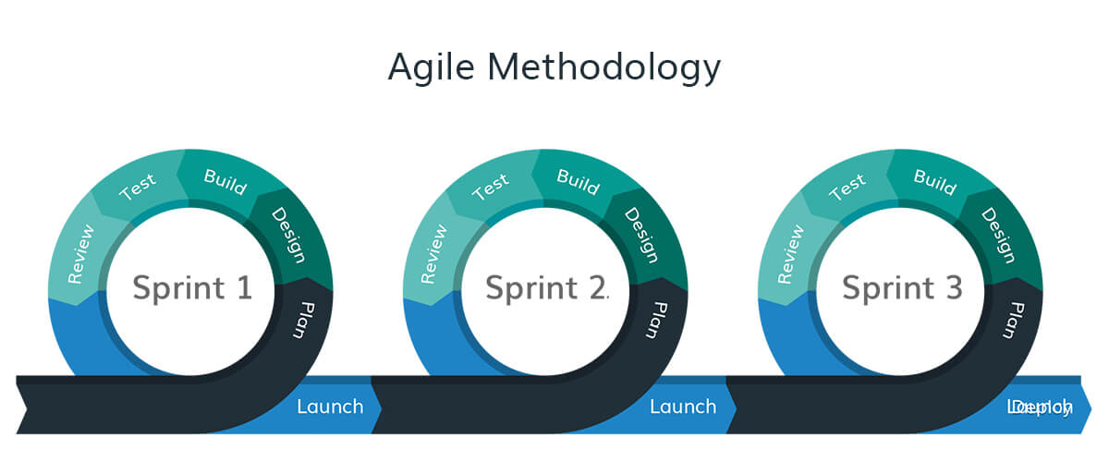
The Agile Approach
Used by most organizations today
The heart of Agile approach is iterative development, intensive communication, and early customer feedback
It’s all about working in close collaboration both across the team and with the customers
At the end of each iteration, stakeholders review the development progress and re-evaluate the priority of tasks for the future iteration to increase the return on investment (ROI) and ensure alignment with user needs and business goals
Also allows for continuous software improvement with easy fixes and changes, quick updates, and feature addition, and help to deliver applications that satisfy users’ needs better

Slide 5
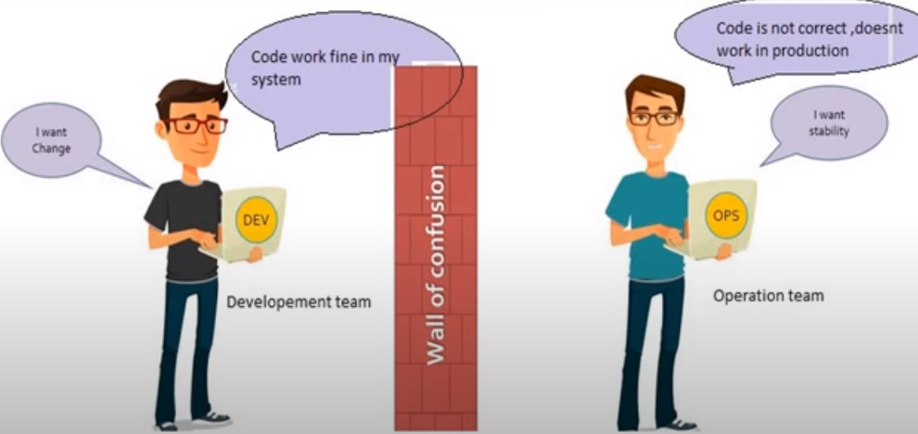
Limitation of the Agile Approach

Slide 6
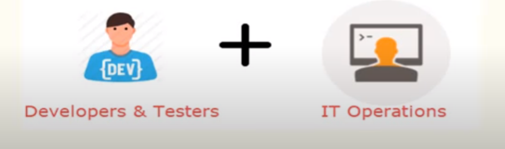
The DevOps Approach – What & Why?
A compound of development (Dev) and operations (Ops), DevOps is the union of people, process and technology to continually provide value to customers
Enables formerly isolated roles—development, IT operations, quality engineering and security—to coordinate and collaborate to produce better, more reliable products
By adopting a DevOps culture along with DevOps practices and tools, teams gain the ability to better respond to customer needs, increase confidence in the applications they build and achieve business goals faster

Slide 7
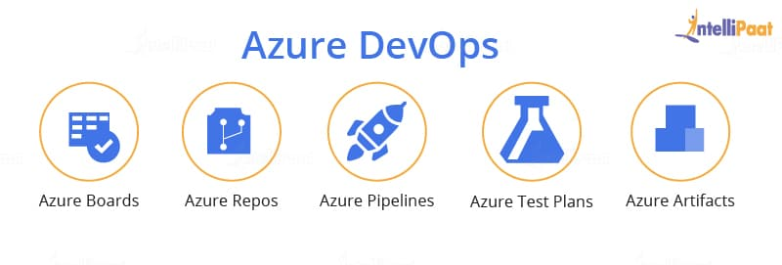
Azure DevOps – What is it?
A Software as a service (SaaS) platform from Microsoft that provides an end-to-end DevOps toolchain for developing and deploying software
Comprises a range of services (known as Azure DevOps services) covering the full development life-cycle

Slide 8
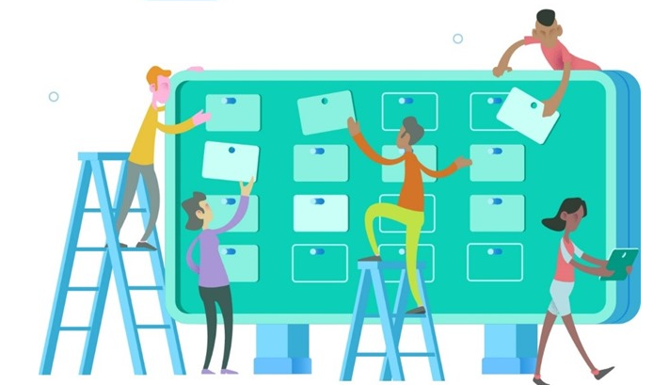
What is Azure Boards?
An interface that allows tracking of tasks, features, and even bugs that may be associated with a project in its entire development lifecycle
Allows the team to track their tasks, work status, user stories, backlogs, features, and track bugs and defects that are noticed in the project
An Azure DevOps service for managing the work for software projects

Slide 9
Why Azure Boards?
Highly customizable Kanban Boards which support different work processes
Manage Backlogs
Manage Sprints
Rich canvas for creating Dashboards
Rich query engine

Slide 10
Azure DevOps – Basic Terms
Organization
A mechanism for organizing and connecting groups of related projects
Examples include business divisions, regional divisions, or other enterprise structures
Project
Provides a repository for source code and a place for users to plan, track progress, and collaborate on building software solutions
Represents a fundamental container where data is stored when added to Azure DevOps
Team
A team is a unit that supports many team-configurable tools
Contains one or more administrators
Team settings are managed by the team administrator role
Users assigned as team administrator can configure and manage all team tools

Slide 11
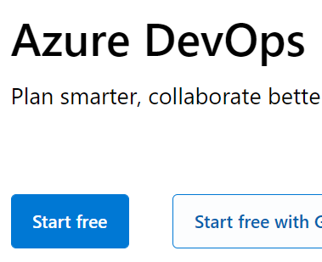
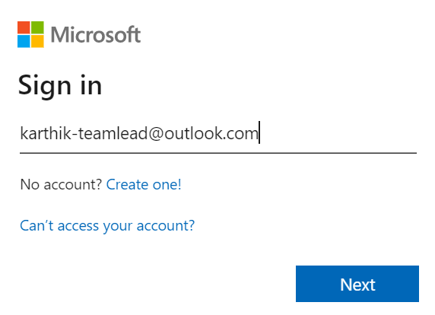
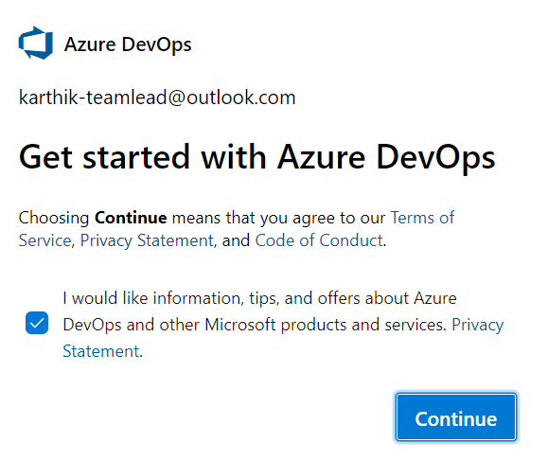
Azure DevOps – Setting up the core environment (1)
Create an Azure DevOps account
Create a new Microsoft Account
Navigate to dev.azure.com
Create a free DevOps account
1
2
3

Slide 12
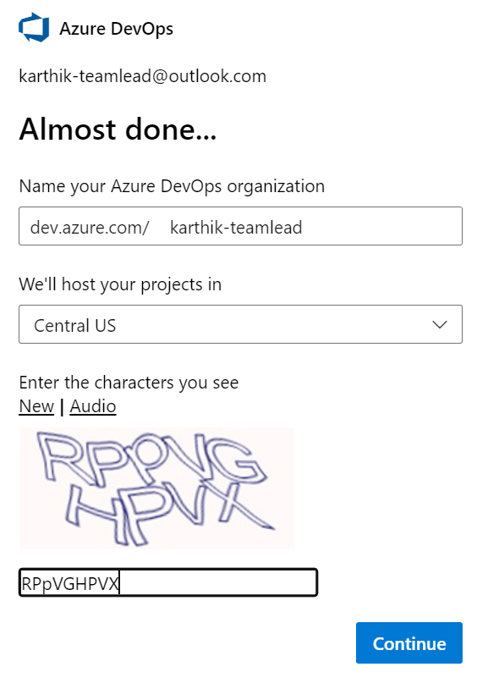
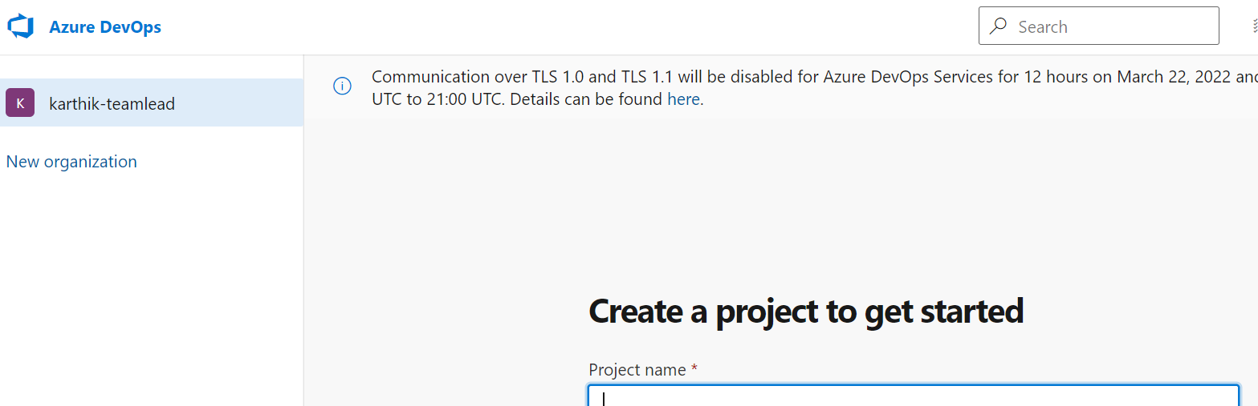
Azure DevOps – Setting up the core environment (2)
Create an Azure DevOps account
Create a new Microsoft Account
Navigate to dev.azure.com
Create a free DevOps account
The landing page
4

Slide 13
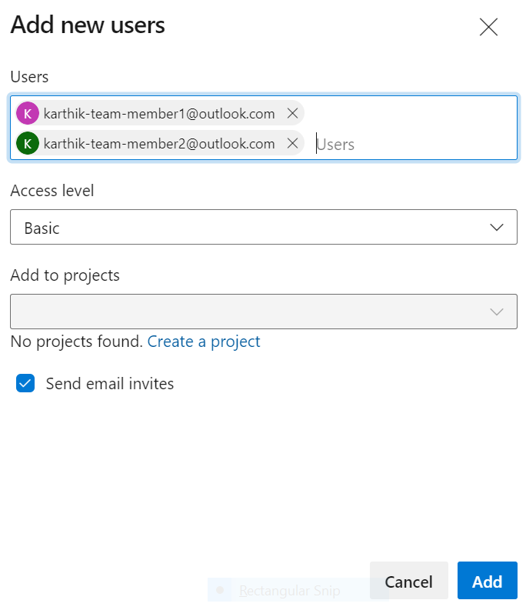
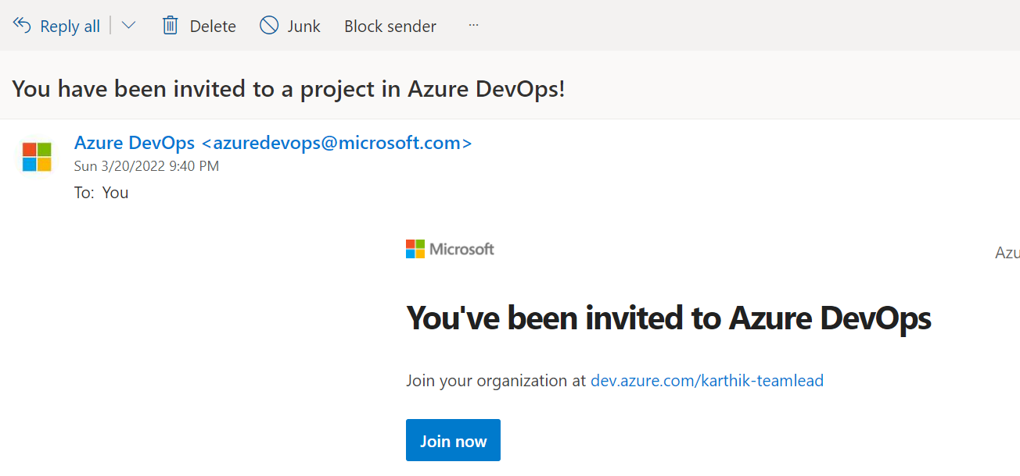
Azure DevOps – Adding Users into Organization
Add users into the organization (Organization Settings → Users)
Users will then receive invites via email

Slide 14
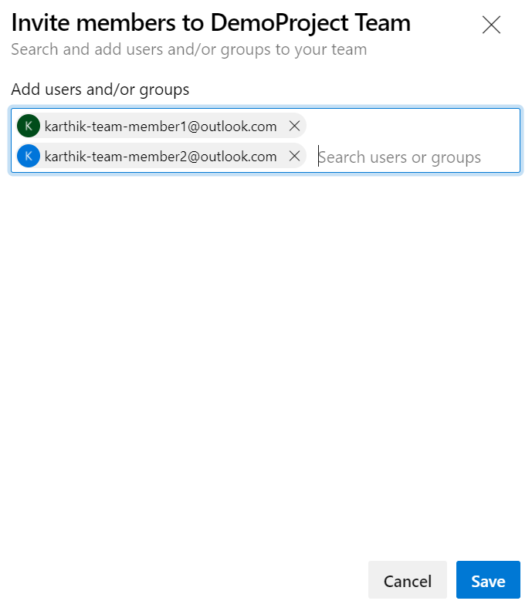
Azure DevOps – Create a new project & add Members
Project Visibility -> Private
Version Control → Git
Work item process → Scrum
Project Settings → Teams → Click on default team

Slide 15
Azure DevOps – Configure the team settings
Set the Backlog navigation levels (Project Settings → Team Configuration →)
Set the team working days (Project Settings → Team Configuration→)

Slide 16
Azure DevOps – Create Releases & Sprints
Project Settings → Project Configuration →
Delete existing Sprints & start adding releases & sprints under each release
Make the releases and sprints available to the team

Slide 17
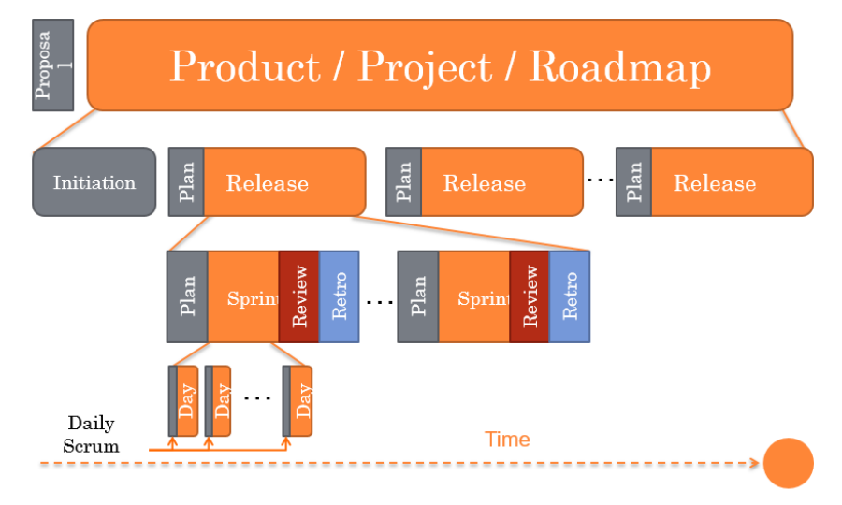
Azure DevOps – Scrum Lifecycle (1)

Slide 18
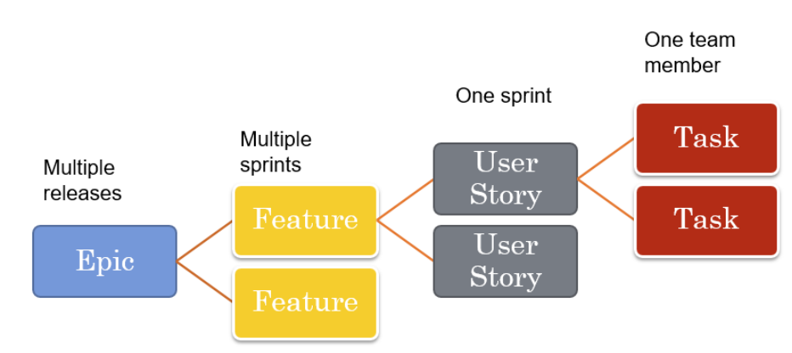
Azure DevOps – Scrum Lifecycle (2)

Slide 19
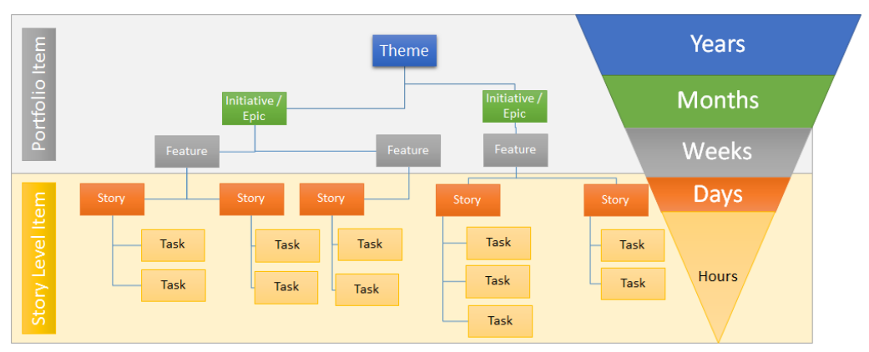
Azure DevOps – Scrum Lifecycle (3)

Slide 20
Azure Boards – Basic Terms
Work Item
Are where you and your team describe the details of what’s needed
Each work item uses a state model to track and communicate progress
As work progresses, items are updated accordingly, allowing everyone who works on the project to have a complete picture of where things are at
Differs based on the work item process selected
Work Item Process
Defines the building blocks of the work item tracking system
Determines the work item type and workflow
Workflow
Consists of a set of states, the valid transitions between the states, and the reasons for transitioning the work item to the selected state
Differs based on the process chosen

Slide 21
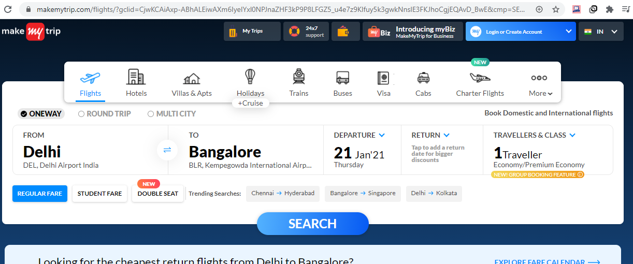
Azure Boards – Simple Use Case
Creation of an online travel booking system like makemytrip.com

Slide 22
Azure Boards – Use Case Implementation
Put the requirements at a high level in an excel sheet
Map the requirements to Scrum work items in Azure Boards

Slide 23
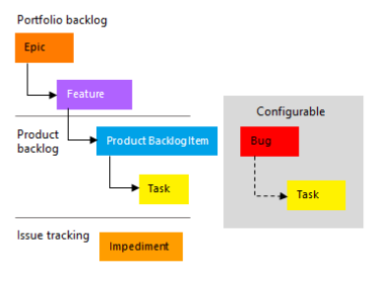
Azure Boards – Simple Use Case
Work Item relationship in Scrum methodology

Slide 24
Azure Boards – Step 1
Create the work items with their relationships
Hide/Show columns
Email work item(s)
Work with Kanban board (Sprint Taskboard) → move items between states
See the history of a work item
Move work items to a different sprint if required
Use Boards to deal with user stories (move from one state to another)
Perform a search in the Work Items screen using acronyms or tags, etc.

Slide 25
Azure Boards – Queries & Charts
Generate lists of work items based on the filter criteria provided
Save and share these managed queries with others
Create shared queries with @Me or @CurrentIteration to specify current user or iteration
Specify flat list or tree of work items in the query results
Create charts based on the query (group by some criteria)
Pin the charts to the dashboard
Email query results if required
Add widgets to the dashboard (for example, Assigned to me or query results widget to the dashboard)

